Slide 1
Guardians of the Galaxy RDF Tutorial
Marshanah Taylor

Slide 2
Overview
Describe the data you are working with – what field/domain does it come from; what is being modeled?
Descriptive information about fictional marvel comic book characters.
What does your document describe or what does your code do?
The RDF document describes the Classes and Properties belonging to characters from the Guardians of the Galaxy (GOTG)
What makes this interesting? (This can be why it’s interesting to you or a pitch for why it should be interesting to someone else)
It details origin/background information that fans of the movies may not have known about their favorite characters, especially if they do not follow the comics.

Slide 3
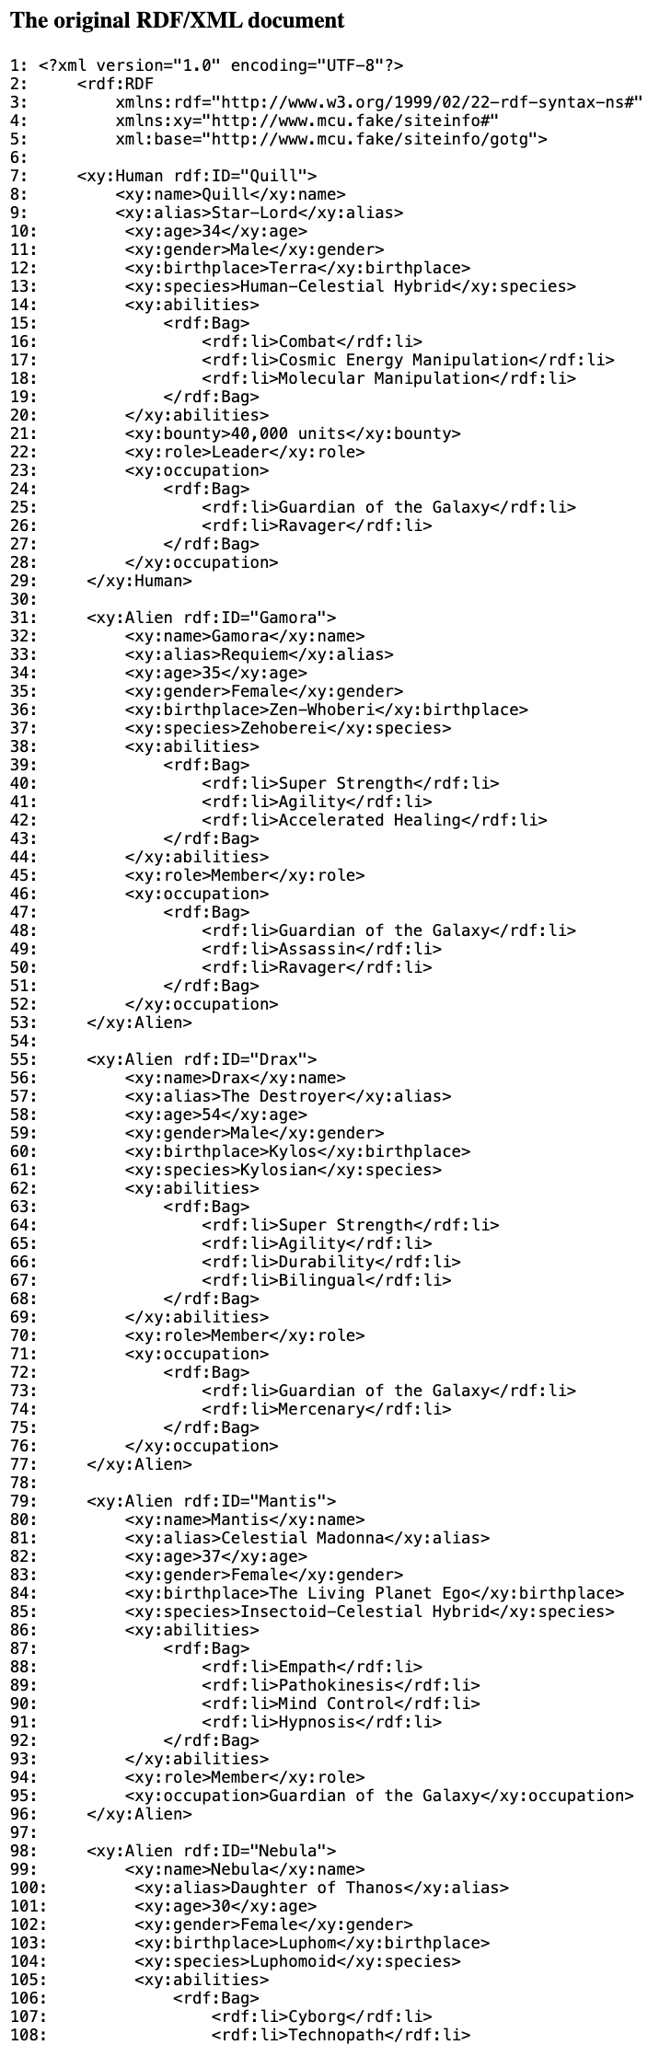
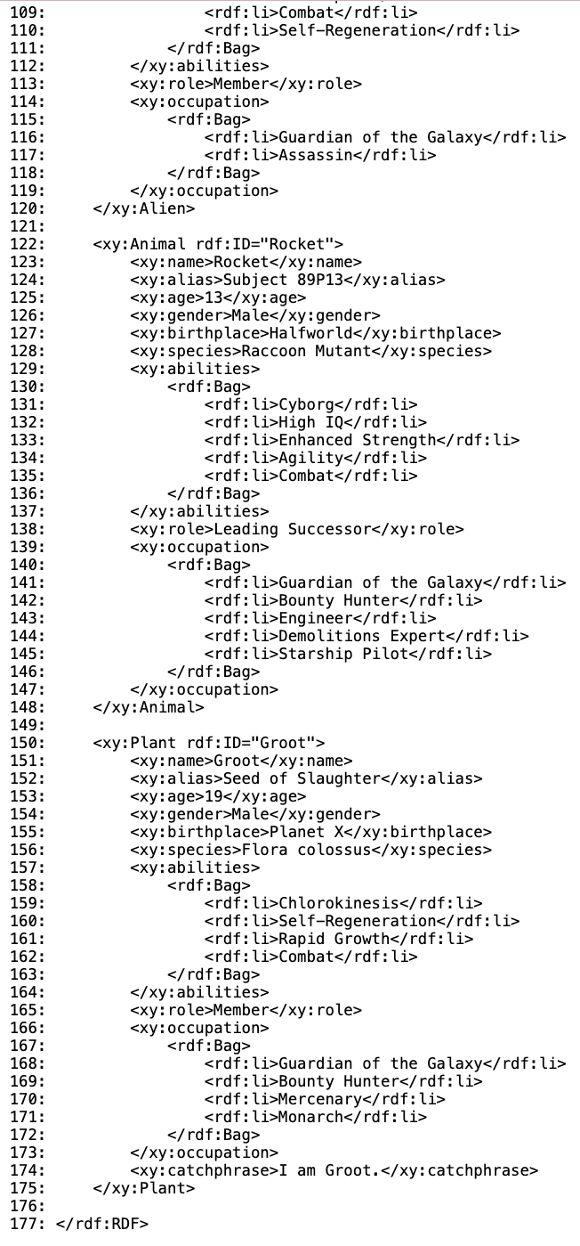
GOTG RDF (Original Document)
Describes 7 Guardians (instances): Quill, Gamora, Drax, Mantis, Nebula, Rocket, and Groot.
Each Guardian has been assigned one of 4 Classes: Human, Alien, Animal, or Plant.
Each Guardian has also been assigned at least 9 or 10 descriptive Properties: name, alias, age, gender, birthplace, species, abilities, bounty, role, occupation, and catchphrase.

Slide 4
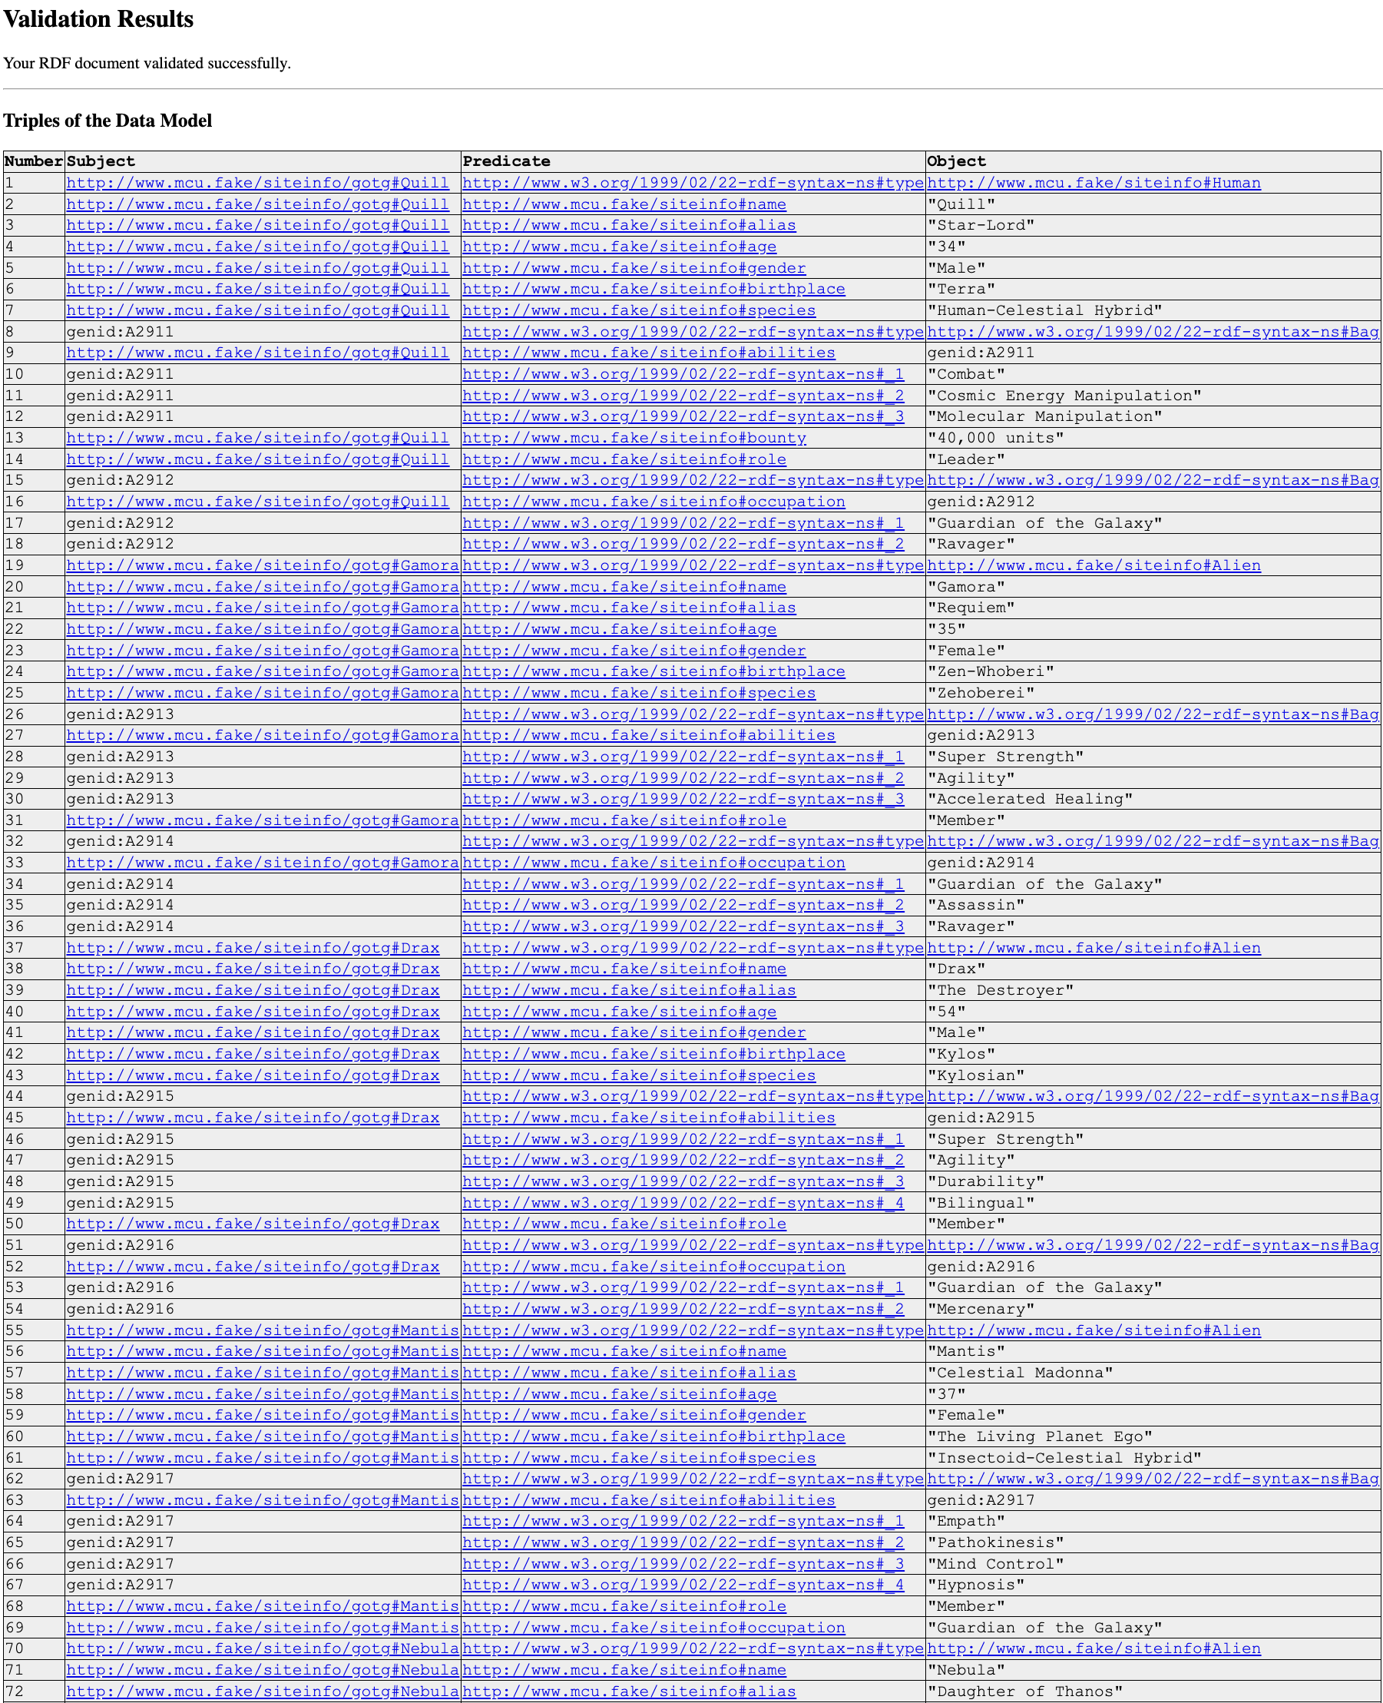
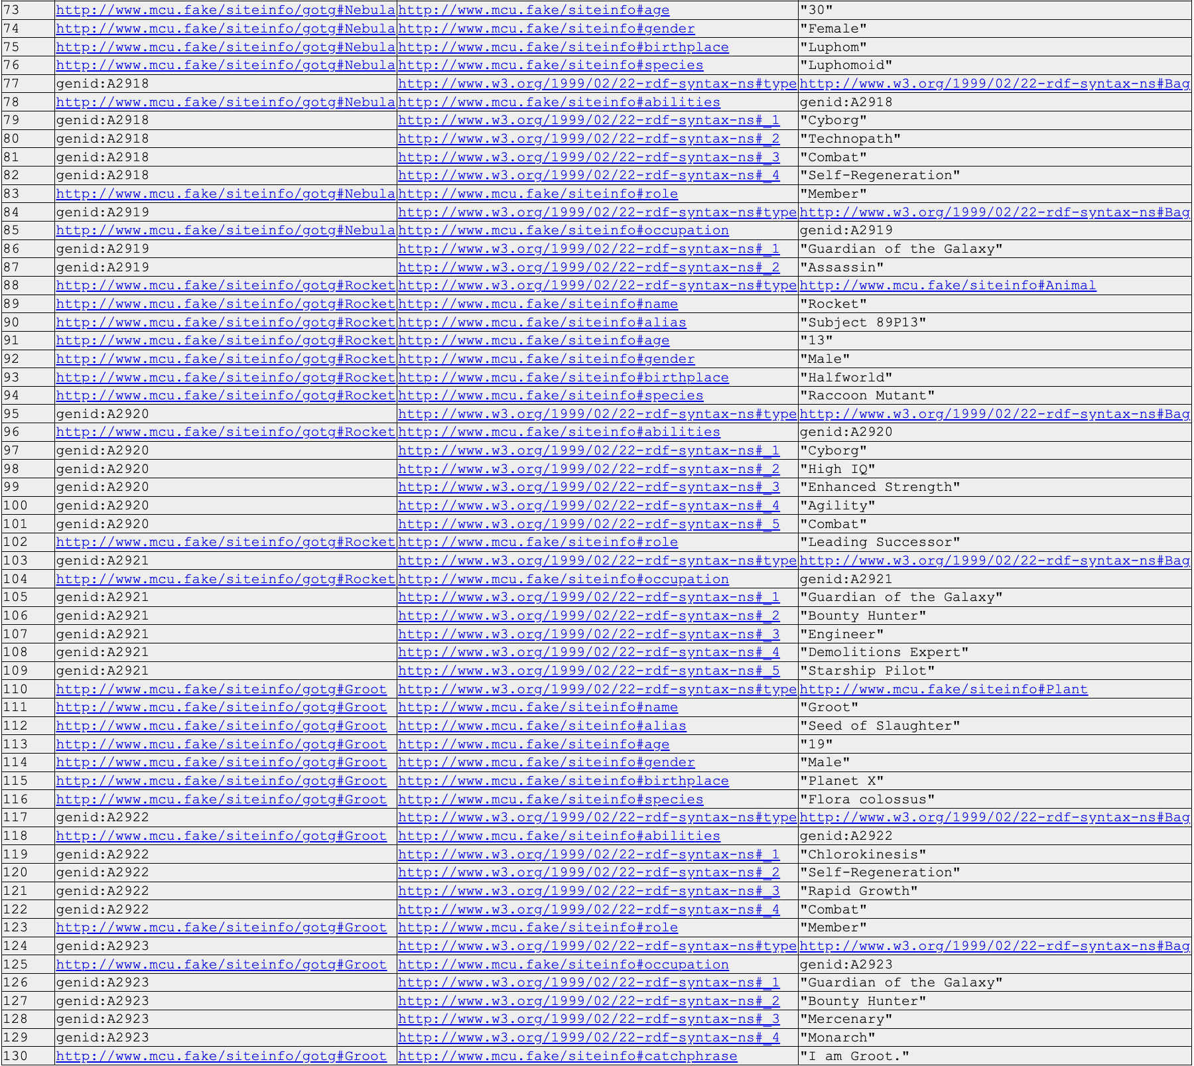
GOTG RDF (Generated Triples w/ Validation)

Slide 5
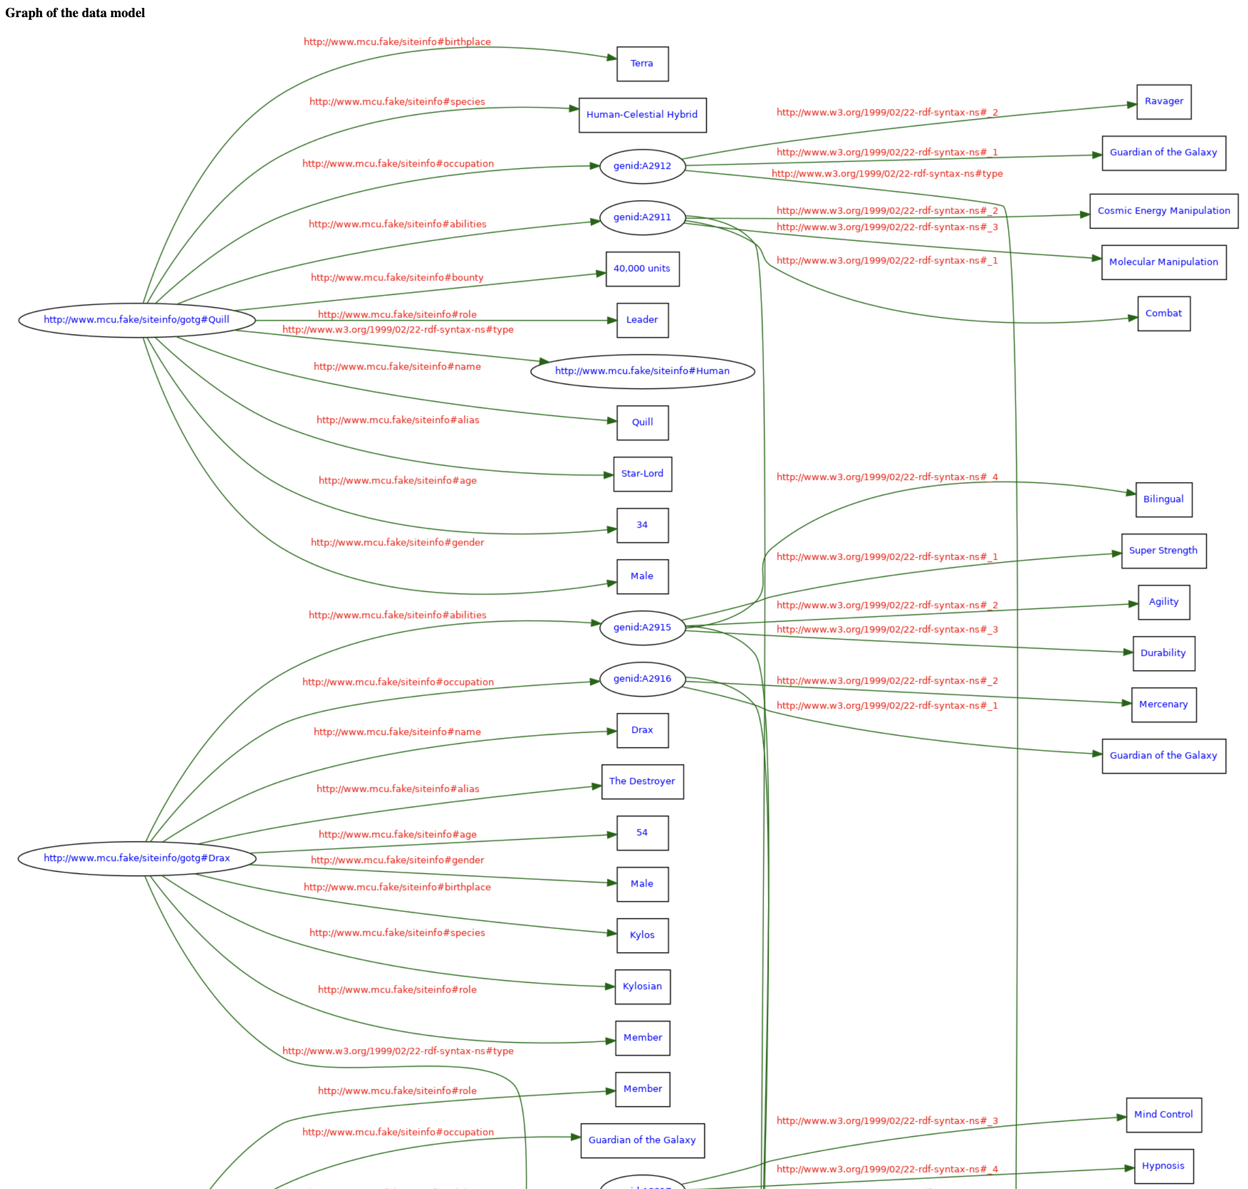
GOTG RDF (Graph Model Pt. 1)

Slide 6
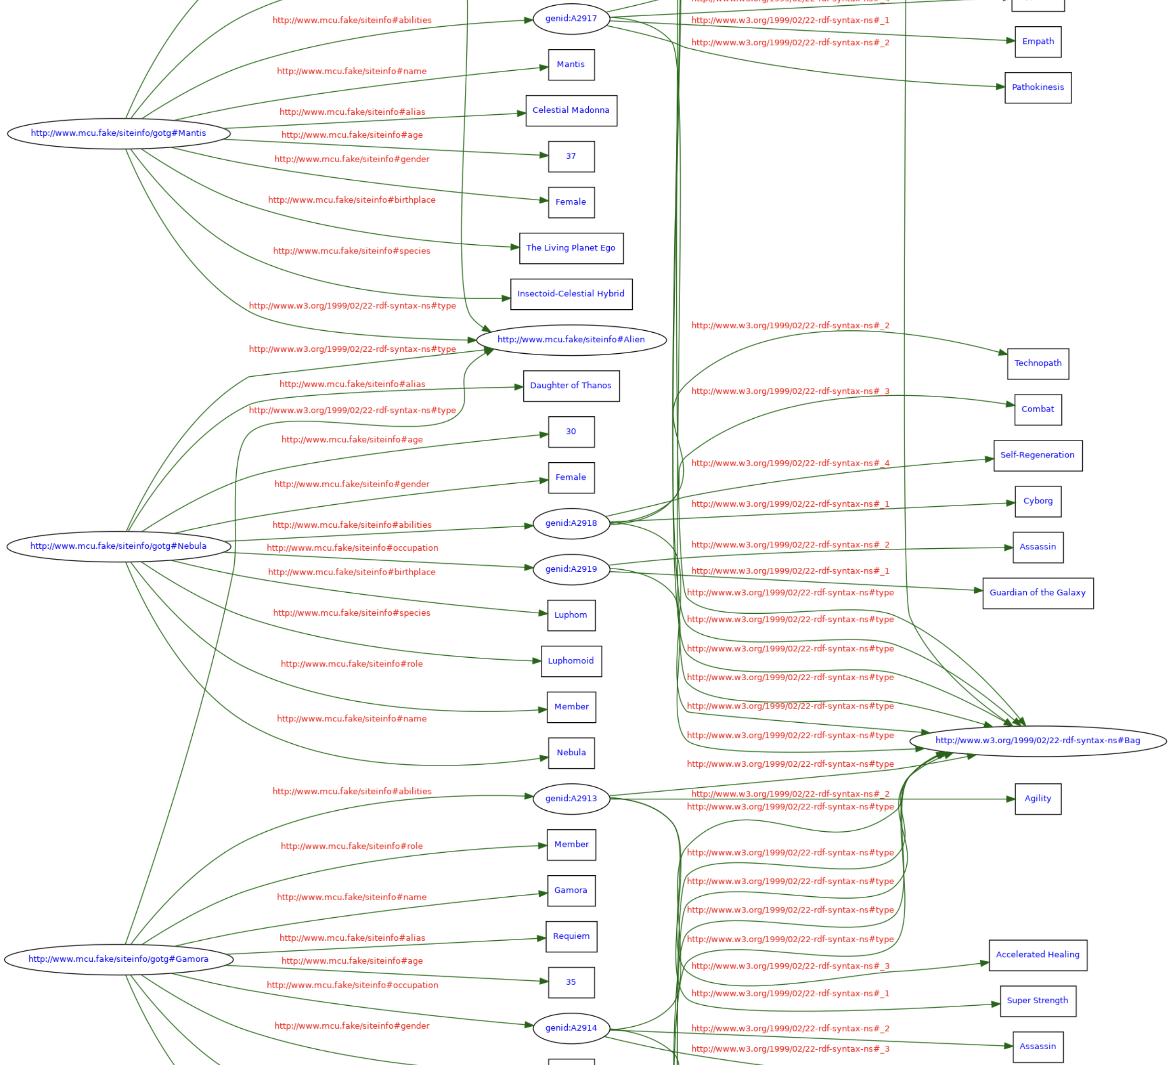
GOTG RDF (Graph Model Pt. 2)

Slide 7
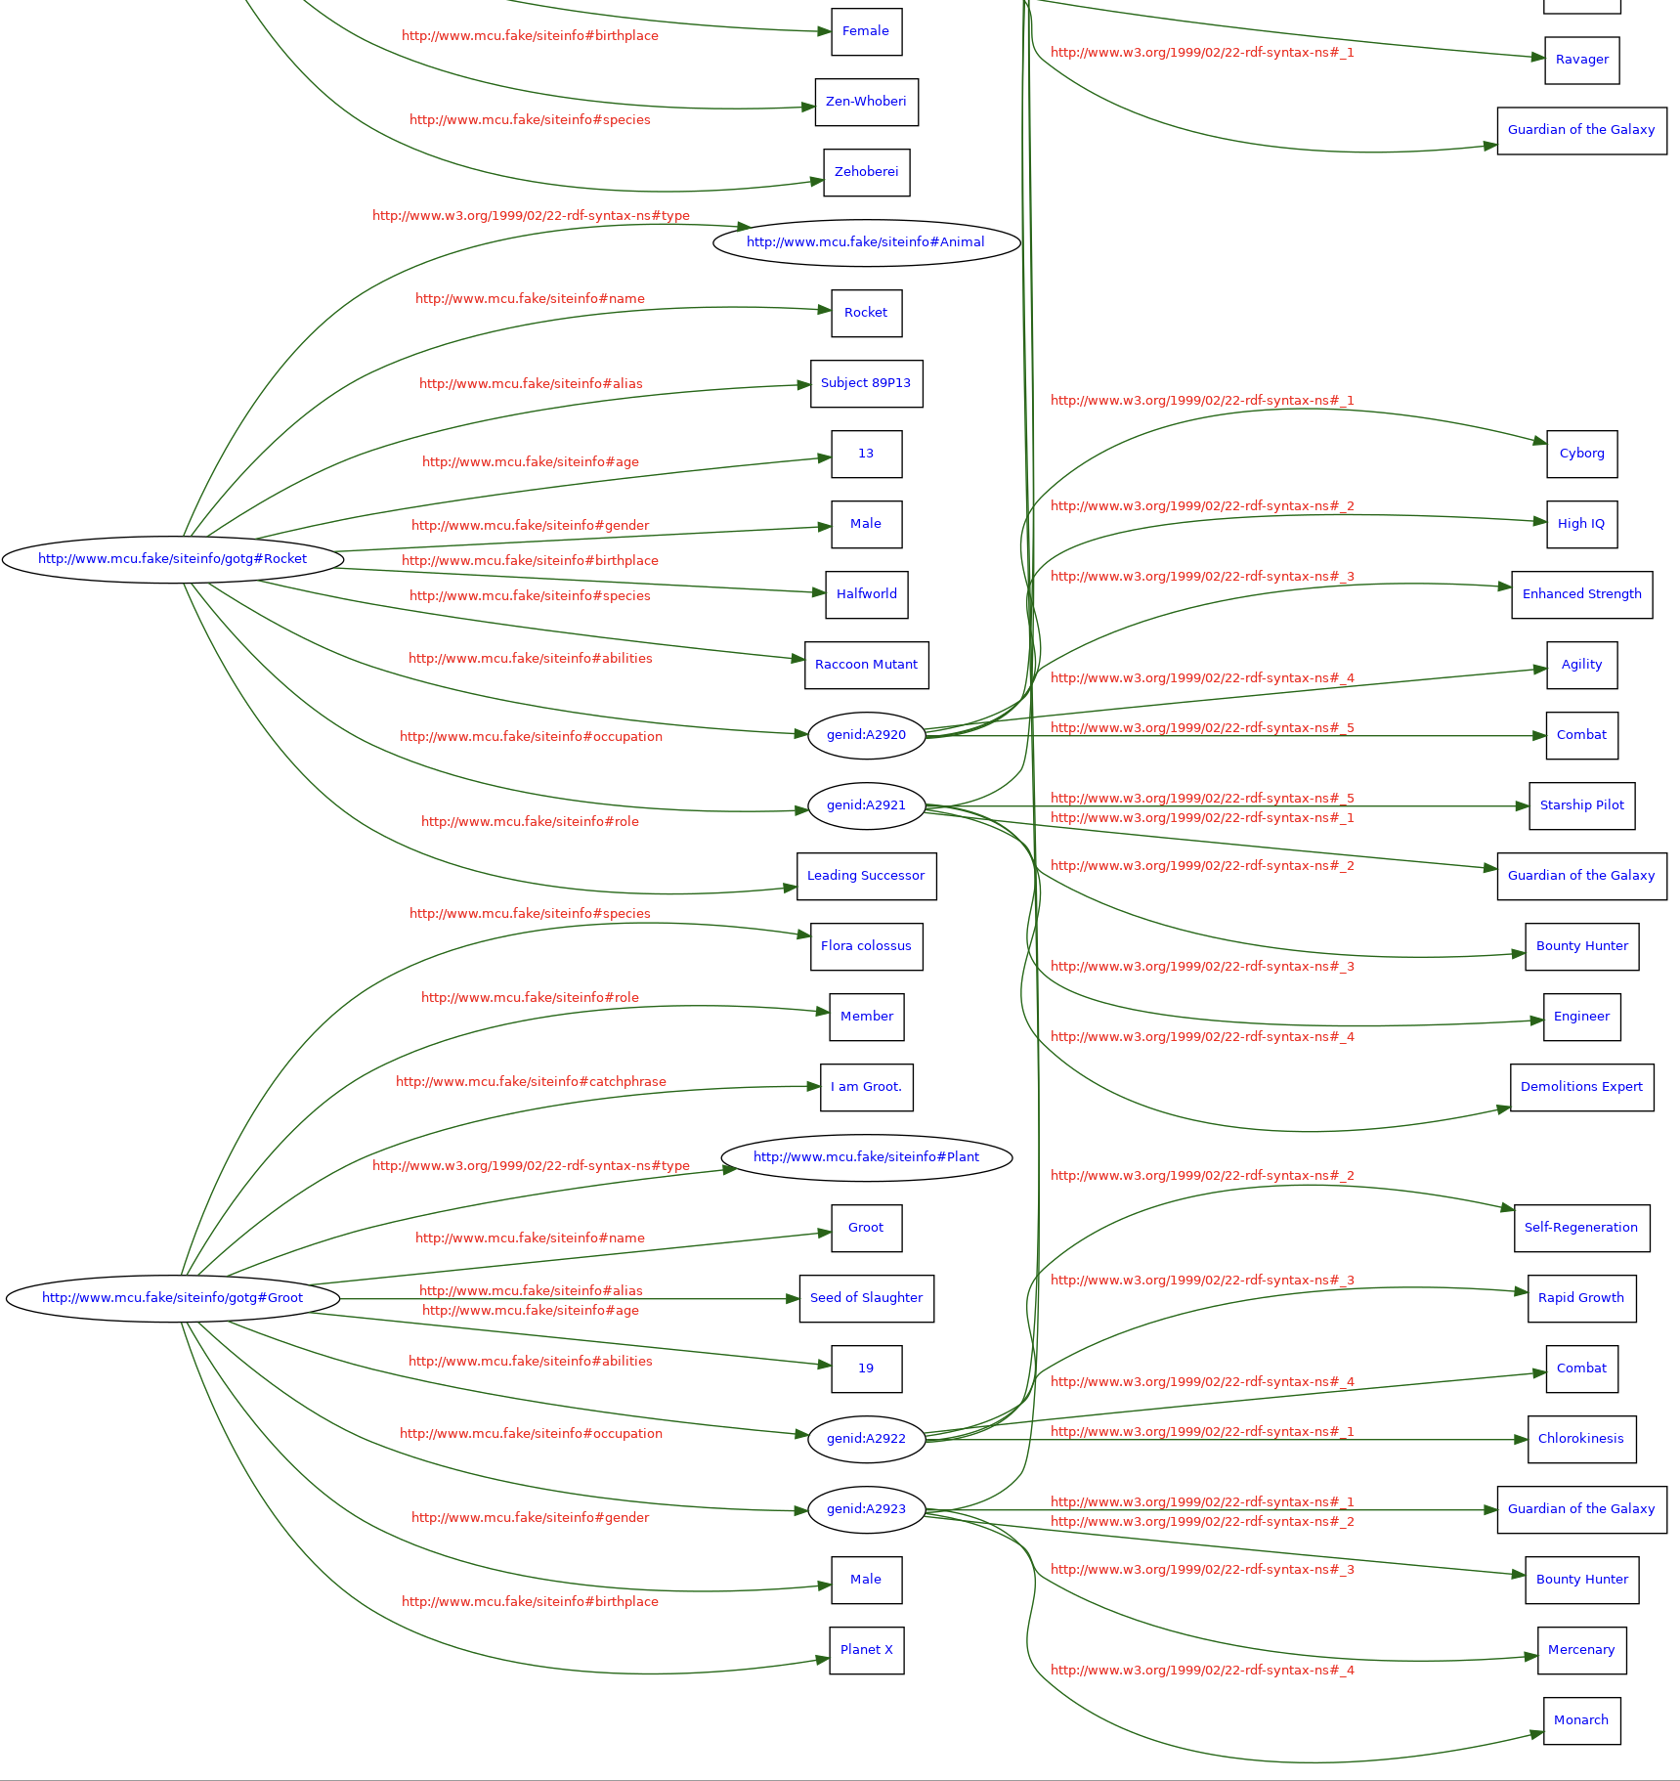
GOTG RDF (Graph Model Pt. 3)

Slide 8
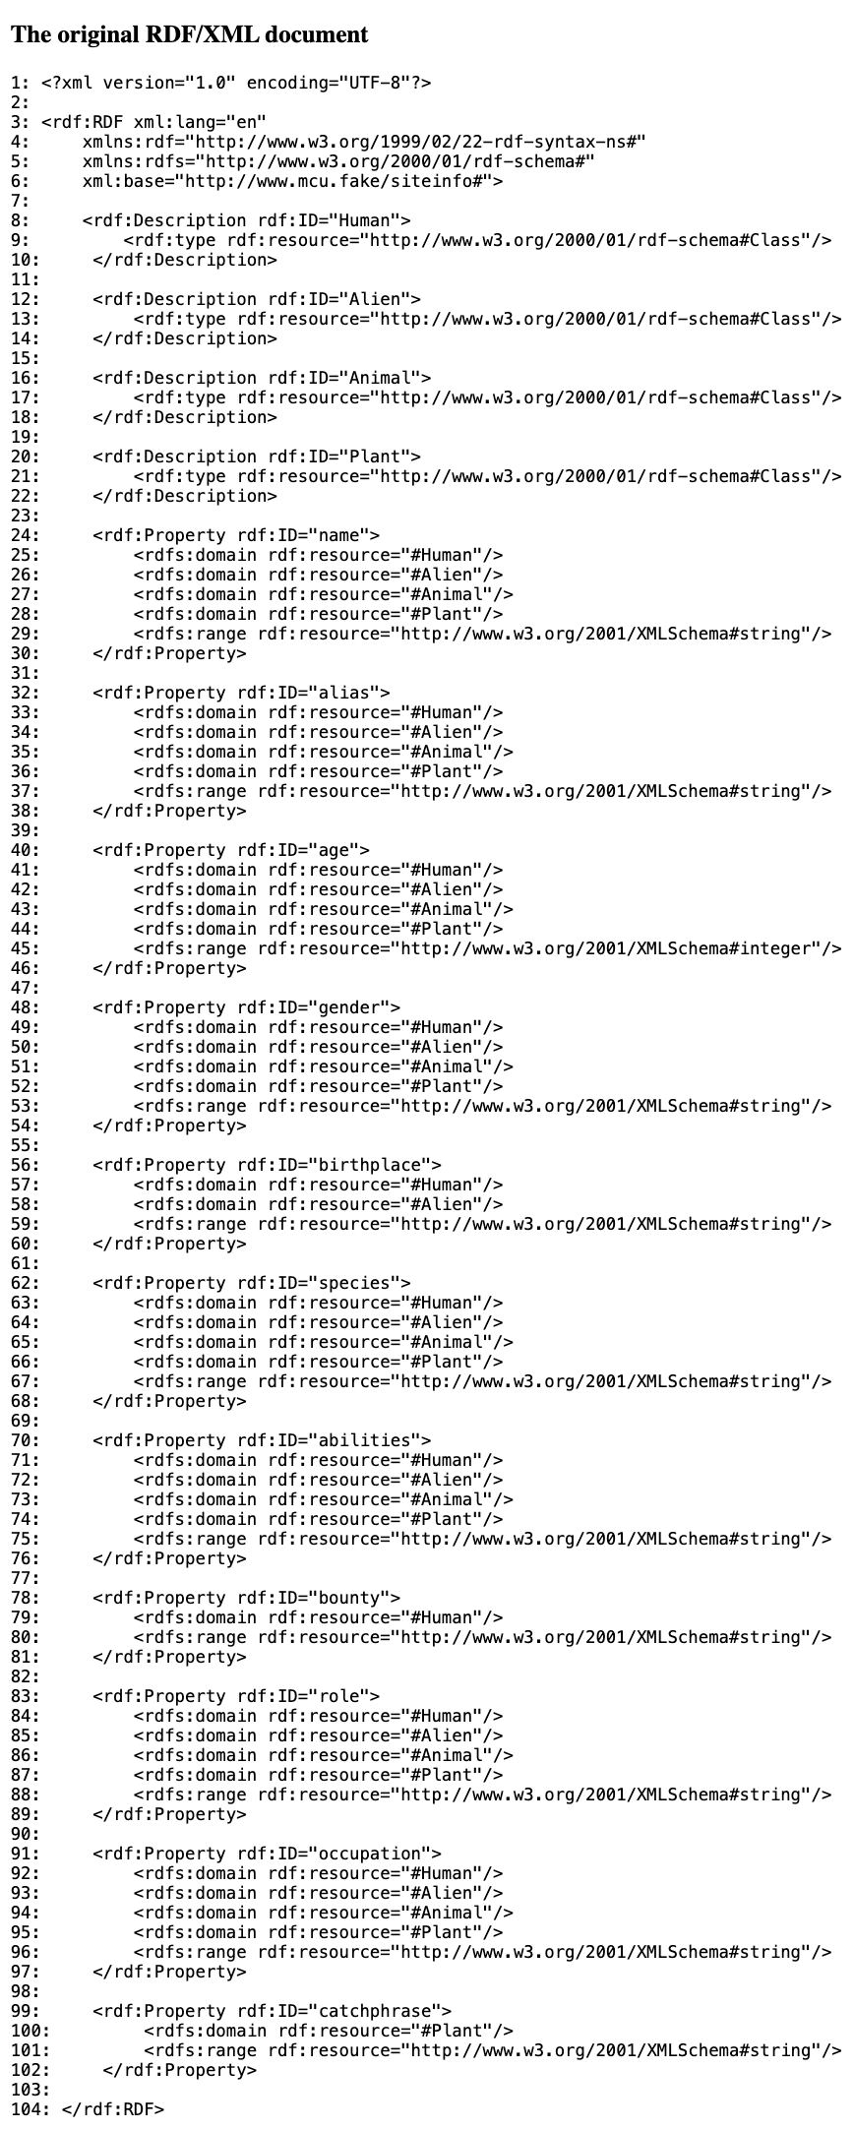
GOTG RDF Schema (Original Document)
Describes the Type of each Class.
For example, a Guardian may be assigned a Type of Class called “Alien”.
Describes the Domain and Range of each Property.
For example, a Property such as ”Age” has integer as its Range and is logically applicable to all four of the specified Domains referenced.
Describes the Datatype of a Property.
In the Schema document, a Property can be written in either a string or integer format.
For example, the “I am Groot.” value under the Plant Class Schema used to describe Groot in the accompanying RDF document references the ”catchphrase” Property from the Schema document, so it must be written as a string.

Slide 9
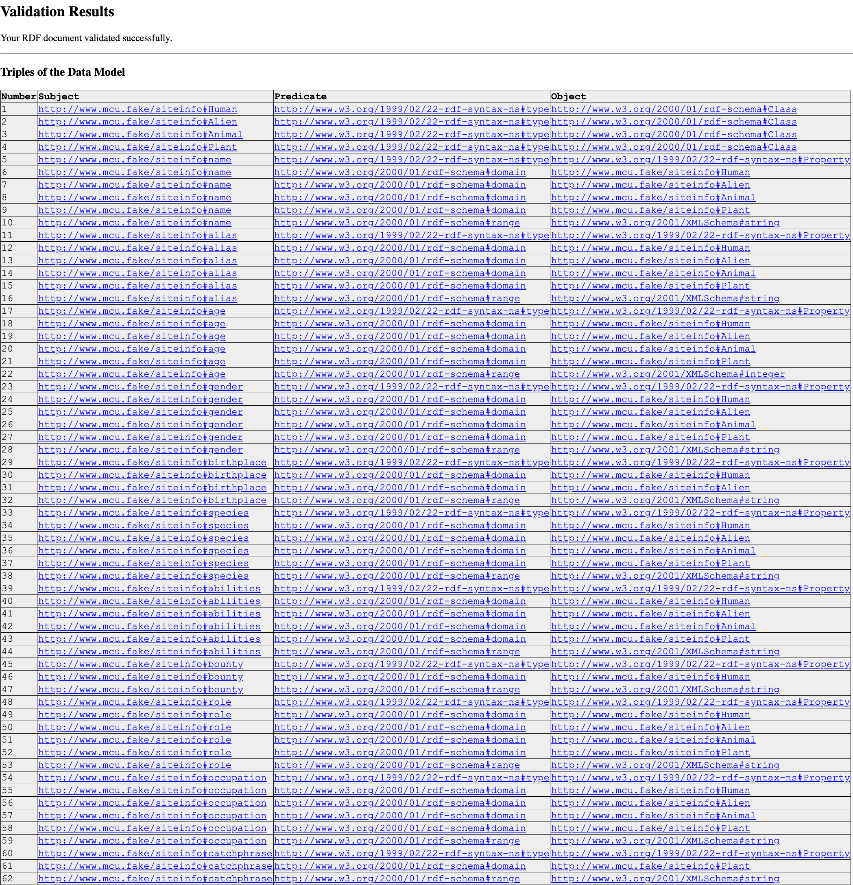
GOTG RDF Schema (Triples w/ Validation)

Slide 10
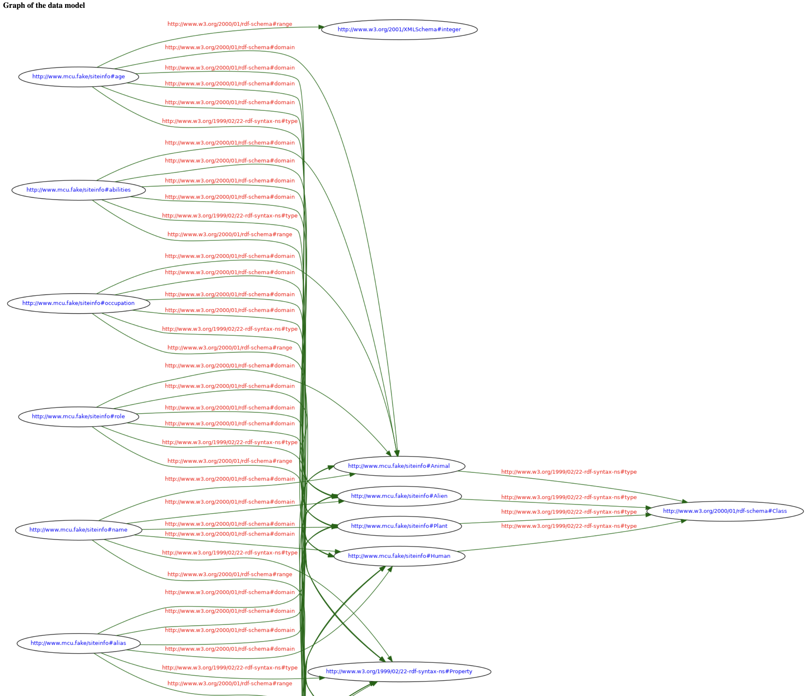
GOTG RDF Schema (Graph Model Pt. 1)

Slide 11
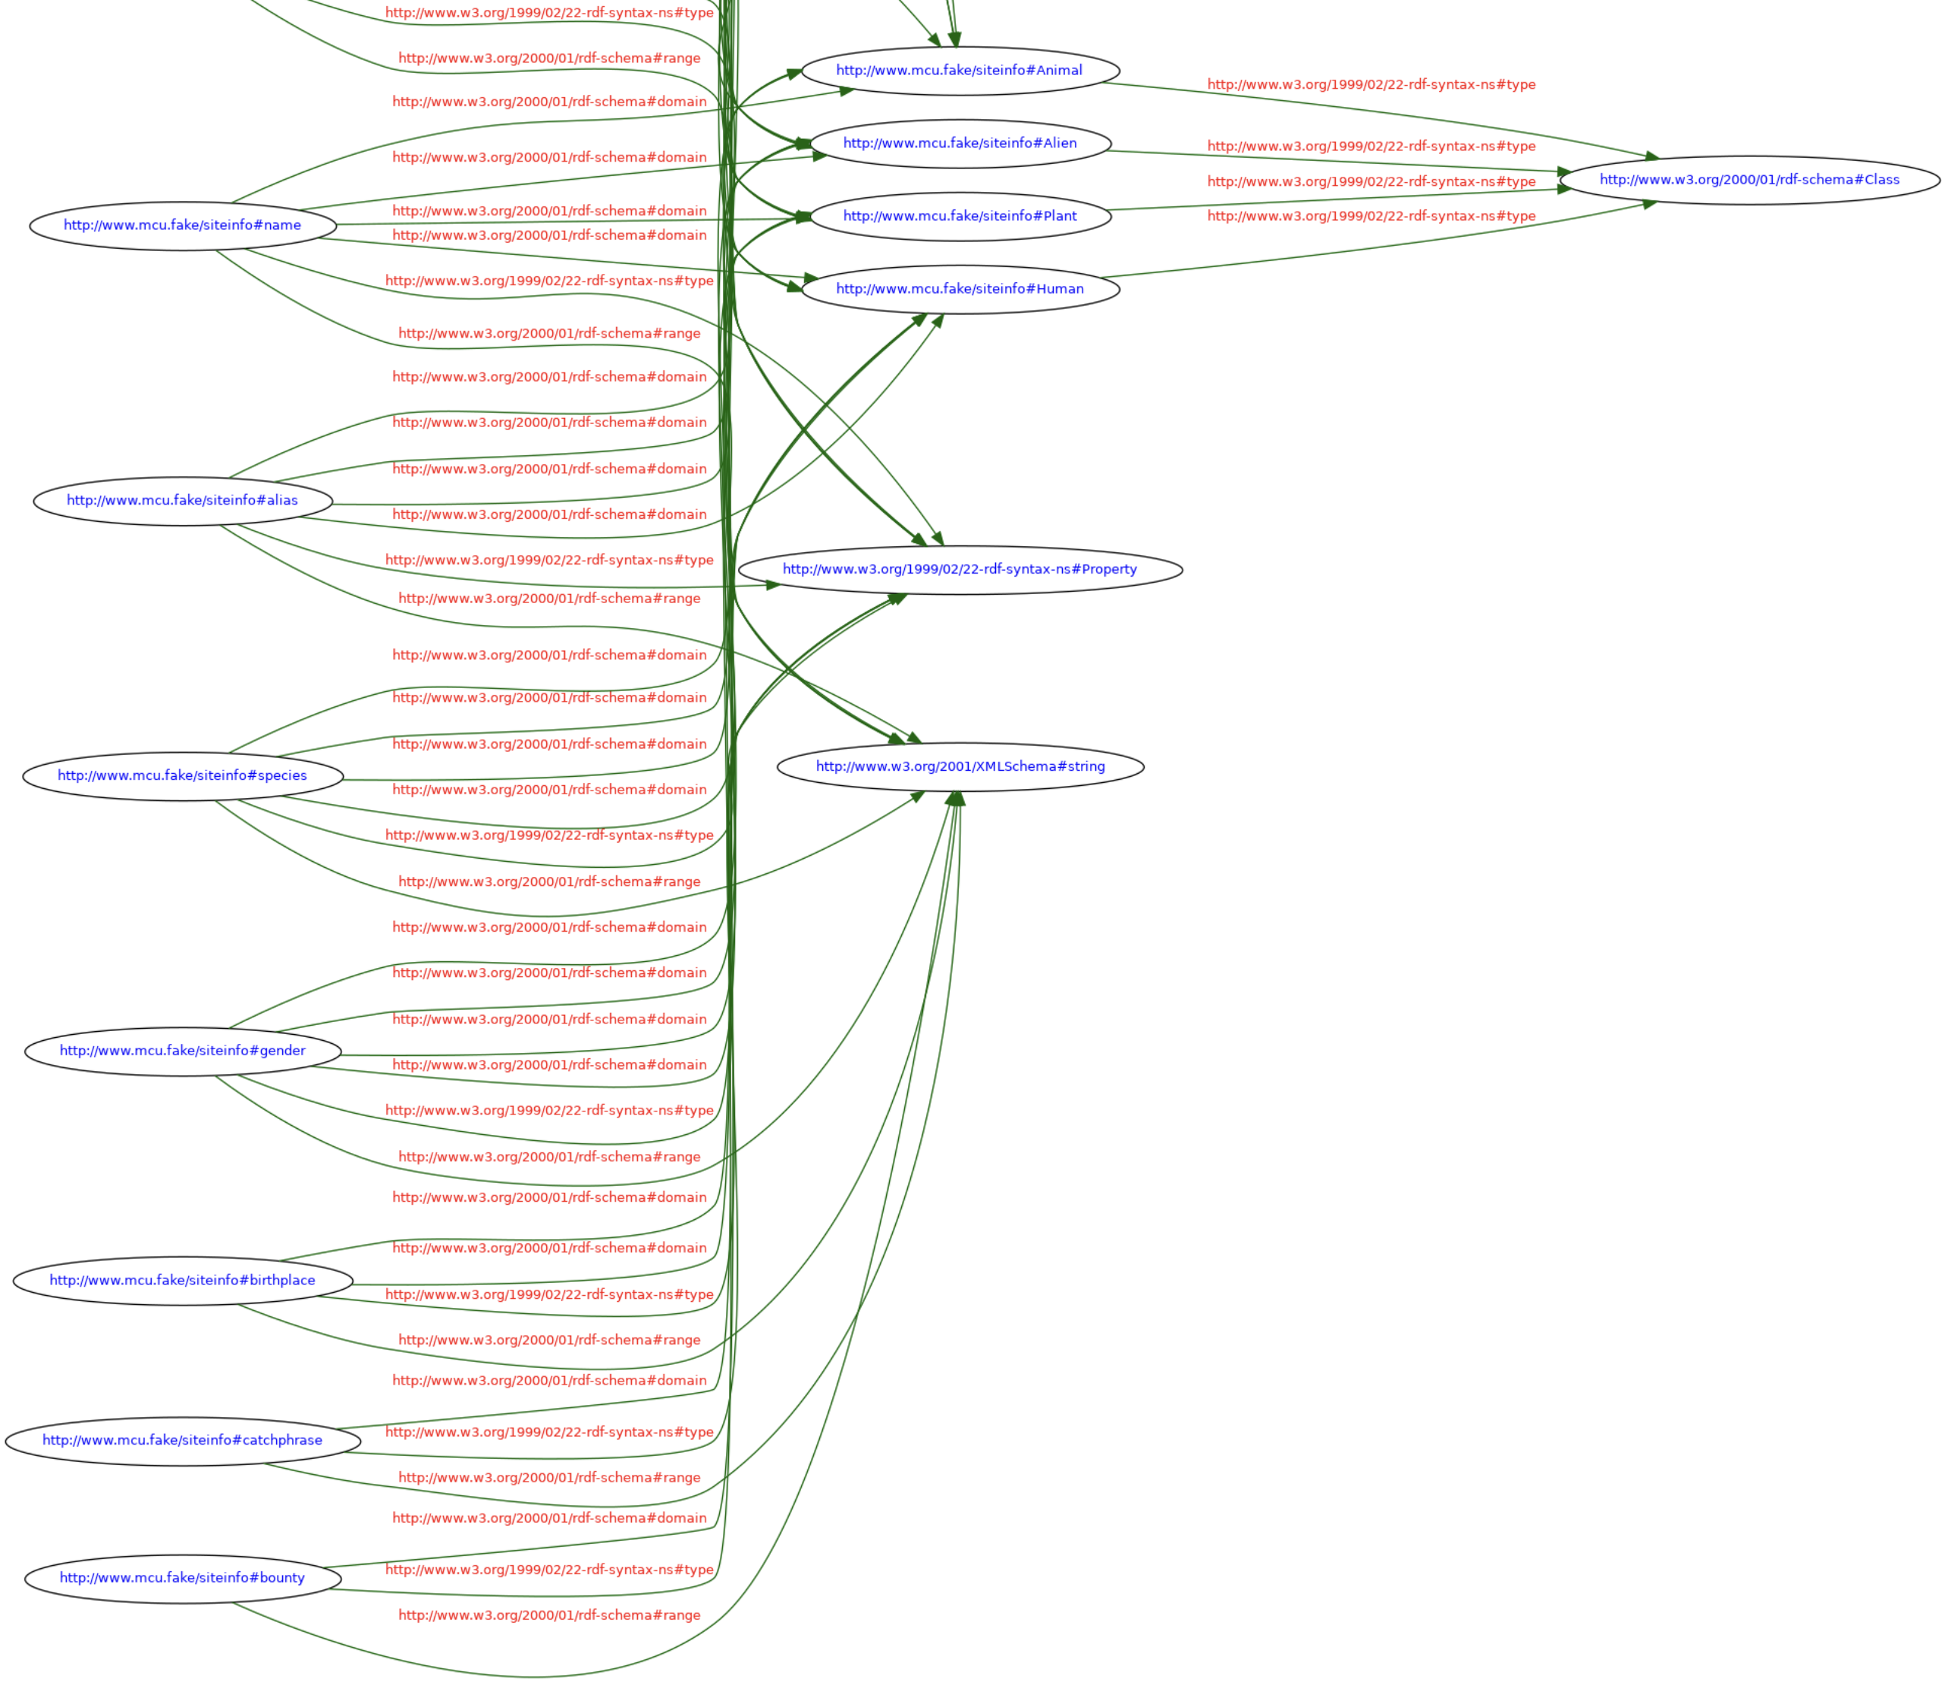
GOTG RDF Schema (Graph Model Pt. 2)

